Slide 1
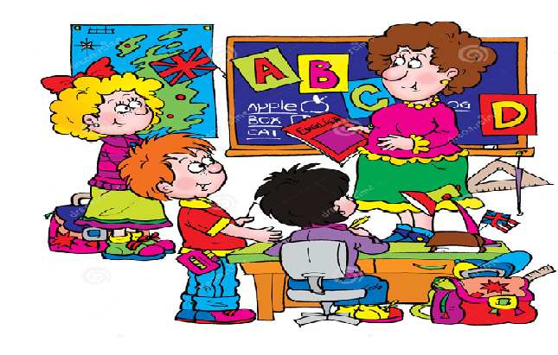
Welcome to our English class!

Slide 2





SS
SCHOOL

Slide 3

Task 1: Read the text and decide whether the following statements are True (T) or False (F).
Up to now, they have been running the new school council for a whole term.
The students are wearing a new uniform at present.
The school council has already made their school better.
This term, the school council and other students are meeting more regularly.

Slide 4

Next term, they will be wearing a new uniform.
started
will finish
now
present
this term
The students are wearing an old uniform.
will start
will finish
future
next term
The students will be wearing a new uniform.

Slide 5
1. Next term, they will be wearing a new uniform.
Future Continuous
S
will be + V-ing
6p.m
now
9p.m
today
We are studying English at VUS.
6p.m
at this time
9p.m
next Thursday
We will be studying English at VUS.
=> An action in progress at a specific time in the future

Slide 6
Future Continuous
Task 2: Make sentences about what George will be doing at the times given.
7.15 | shower
7.50 | breakfast
8.40 | catch bus to school
8.55 | arrive at school
10.30 | maths lesson
=> At 7.15 tomorrow, he’ll be having a shower.

Slide 7
2. I’m flying to Hanoi tomorrow.
Future Continuous
=> I will do the activity in the near future.
I’ve already had a plan to fly to Hanoi.
=> I will be flying to Hanoi tomorrow.
=> to talk about planned events or events that we expect to happen.
=> Next term, we will be meeting more regularly.

Slide 8
Future Continuous
Task 3: Write sentences about these people’s plans.
1. I’m going to the supermarket later.
2. He’s visiting his grandparents next month.
3. She’s watching the football match on TV tonight.

Slide 9
3. When will you leave?
Future Continuous
=> Direct question
=> Can you let me know
when will you leave?
=> Can you let me know when you will leave ?
=> Can you let me know when you will be leaving ?
=> When will you be leaving ?
to make polite enquiries (ask about somebody’s plans politely)

Slide 10
Task 4: Rephrase the questions to make polite questions.
Future Continuous
1. What time are you leaving school?
=> What time will you be leaving school?
2. Are you going to stay overnight?
=> Will you be going to stay overnight?
3. What do you plan to do this evening?
=> What will you be doing this evening?

Slide 11
Future Perfect
4. By the end of the year, they will have made their school better.
S
will have + V-3/ -ed
started
now
They have made the school better.
now
the end of the year
past
present
future
They will have made the school better.
=> to talk about a completed action in the future

Slide 12
Future Perfect Continuous
5. By the end of this week, they will have been running
S
will have been + V- ing
the new school council for a whole term.
past
the end of this week
They will have run the school council for a whole term
now
the end of this week
past
present
future
They will be running the school council.

Slide 13
Future Perfect Continuous
a whole term
the end of this week
past
…will have run… for a whole term.
…will be running…
=> …will have been running for a whole term.
=> to say how long an action will have been in progress in the future => usually used with for + a period of time.

Slide 14

Task 3: Explain the meaning of these sentences
At 4p.m, we’ll watch the film.
At 4p.m, we’ll be watching the film.
By 4p.m, we’ll have watch the film.
By 4p.m, we’ll have been watching the film for an hour.

Slide 15

Practice: Grammar builder p.122

